Slide 1

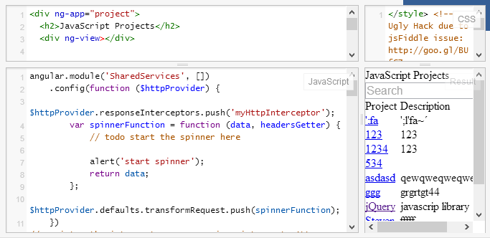

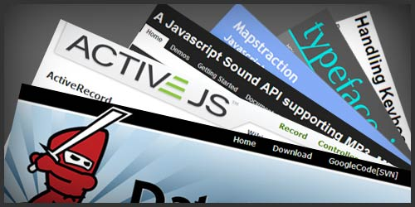
JavaScript SPA
JS Frameworks Course Program, Evaluation, Exams
Telerik Software Academy
Learning & Development Team
http://academy.telerik.com

Slide 2

Table of Contents
What's Coming Next in the Academy?
The JavaScript SPA Course Program
The Trainers Team
Exams and Evaluation
Standard Criteria
Bonuses
Resources for the Course

Slide 3

JavaScript SPA
Coming To The Next Module

Slide 4

What's Coming Next?
A consequence of three web courses
JavaScript SPA
Building client SPA applications
NodeJS
Building data-driven Web applications
ASP.NET Web forms
Building data-driven Web applications
ASP.NET MVC
Building data-driven Web applications

Slide 5
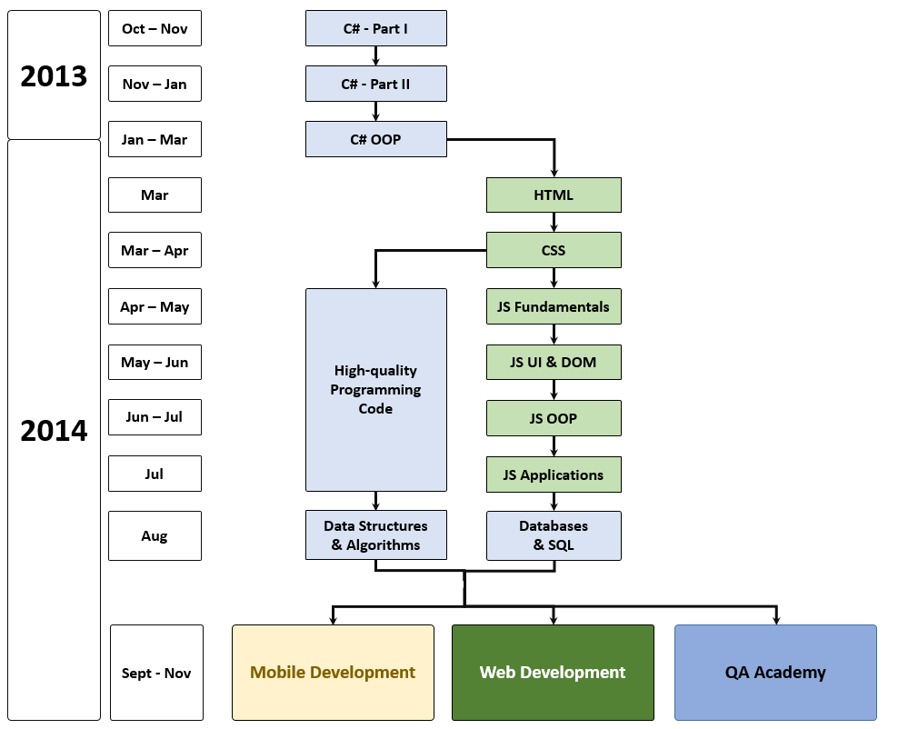
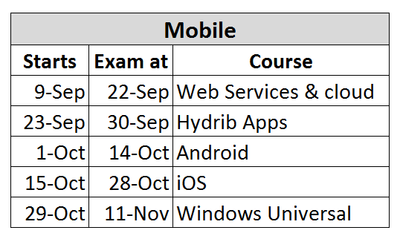
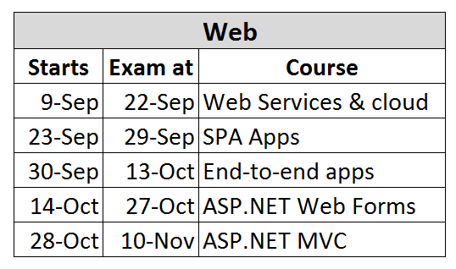
What's Coming Next?

Slide 6

JavaScript SPA – Program
What Will We Cover in the JavaScript Frameworks?

Slide 7


The JS SPA Course Program
AngularJS
Controllers
Views
Routing
App life cycle
KendoUI
Live demo

Slide 8

The Trainers Team

Slide 9
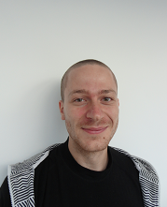
Trainers Team (1)
Ivaylo Kenov
Technical Trainer @ Telerik Software Academy
Graduate from the fourth season of Telerik Software Academy
Mathematical competitions contestant
E-mail: ivaylo.kenov [at] telerik.com
Champion in OOP and DSA
http://ivaylo.bgcoder.com

Slide 10
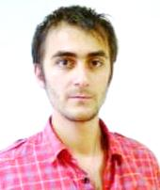
Trainers Team (2)
Doncho Minkov
Senior Technical Trainer @ Telerik Software Academy
Student in Sofia University
Software Engineering
Contestant in the Informatics competitions
Graduate from the first season of Telerik Software Academy
Email: doncho.minkov [at] telerik.com
Blog: http://minkov.it

Slide 11




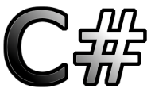
Evaluation
Thank God There Are Bonuses!

Slide 12

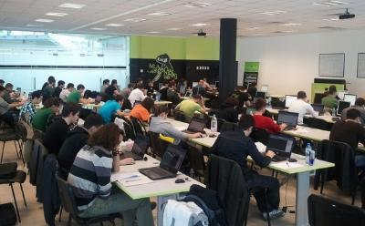
JavaScript SPA – Evaluation
Evaluation components
Practical exam – 65%
Peer review – 10%
Homework – 10%
Homework evaluation – 5%
Attendance in class – 10%
Bonuses
Forums activity – bonus up to 5%

Slide 13


Pass / Excellence / Fail Criteria
Criteria for pass / pass with excellence / fail
Pass with excellence
Very high exam results
or
High total results
Pass
Average total results
Fail
Low total results or low exam results

Slide 14
Homework Peer Reviews
Everyone will get feedback for their homework
Everyone will give feedback for few random homework submissions
Students submit homework anonymously
Please exclude your name from the submissions!
For each homework submitted
Students evaluate 3 random homeworks
From the same topic, after the deadline
Give written feedback, at least 200 characters
Low-quality feedback → report for punishment

Slide 15
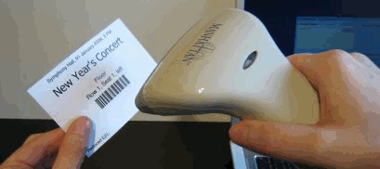
Check Your Presence
From now on you should check your presence on the barcode reader 3 times a day:
In the morning when lectures begin (~10:30)
After lunch break (~13:30)

Slide 16



Use the Same Email!
Please use the same email address in:
http://telerikacademy.com
http://bgcoder.com
http://forums.academy.telerik.com
Otherwise your score could be incorrectly calculated!

Slide 17








Resources
What We Need in Addition to this Course Content?

Slide 18

Course Web Site & Forums
Register for the "Telerik Academy Forums":
Discuss the course exercises with your colleagues
Find solutions for the exercises
Share source code / discuss ideas
The JS SPA official web site:
http://forums.academy.telerik.com/questions/front-end-development/javascript-frameworks
academy.telerik.com/student-courses/software-technologies/javascript-frameworks

Slide 19
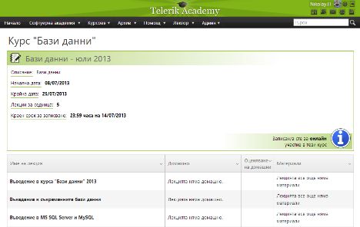
Telerik Integrated Learning System (TILS)
The Telerik Integrated Learning System (TILS)
www.telerikacademy.com
Important resource for all students
Homework submissions
Homework peer reviews
Presence cards with barcode
Reports about your results
telerikacademy.com/Courses/Courses/Details/110

Slide 20


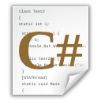


JavaScript Frameworks
http://academy.telerik.com

Slide 21




Free Trainings @ Telerik Academy
C# Programming @ Telerik Academy
csharpfundamentals.telerik.com
Telerik Software Academy
academy.telerik.com
Telerik Academy @ Facebook
facebook.com/TelerikAcademy
Telerik Software Academy Forums
forums.academy.telerik.com

